Slide 1
Munish Arora
Microsoft Certified Trainer

Slide 2
About Exam
This course equips you with all skills required to be a successful data analyst.
Data Analyst:
Responsible for
Profiling, cleaning, and transforming data,
Designing, and building scalable and performant data models, and
Enabling and implementing the advanced analytics capabilities into reports for analysis.

Slide 3
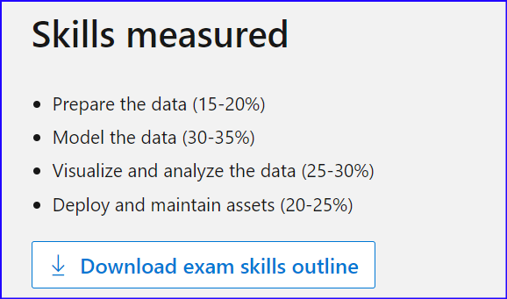
Exam
Skills measured:
Refer to https://docs.microsoft.com/en-us/learn/certifications/exams/pl-300
As you scroll down, it will show when was it changed.
Download the exam skills outline, and make sure that thoroughly understand each bullet point and make yourself comfortable answering the related questions.

Slide 4
Exam Pattern
The duration of exam is roughly 180 minutes, and you should expect around 55-56 questions.
The questions were mostly simple to answer despite exhaustive details.
There are usually 2 case studies, In case of case studies
there will be 5-6 questions with each case study which you need to read carefully.
Once you submit case study answers, you can not go back.
So, it usually is
First case study , then 5-6 questions, you can not go back once you submit and move next
Then 40-45 questions, there you can go forward and back
Then final case study , then 5-6 questions, you can not go back once you submit.

Slide 5
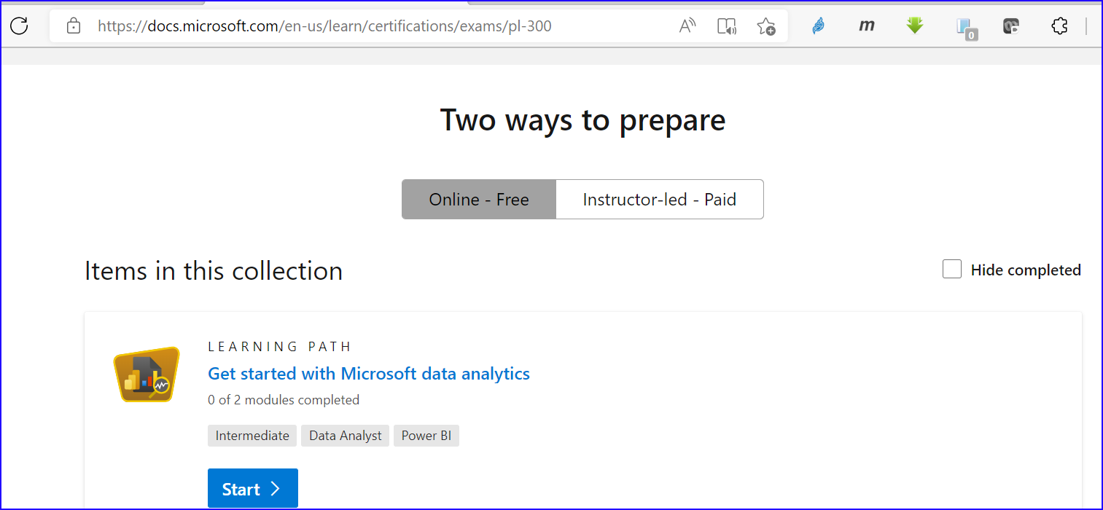
How To Prepare
The 1st and foremost are the FREE Microsoft learning path tracks. You can find it right below the exam detail page, where-in they cover every topic from the skill set.
You will also get some valuable quizzes at the end of each section to test your knowledge.

Slide 6
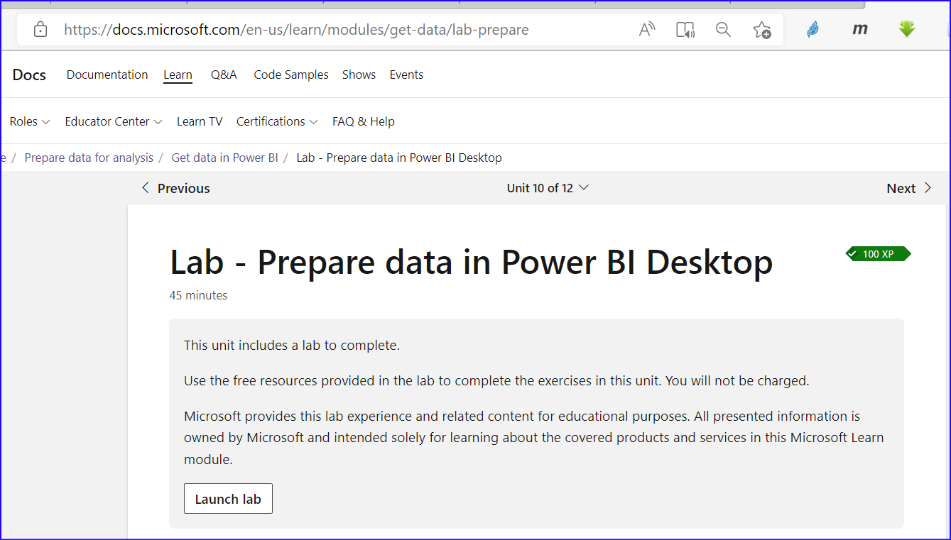
How To Prepare
Further, you can also play with the labs. You don’t need to pay anything. You just need to have a Microsoft account.
Click on the button

Slide 7
Prepare The Data (15-20%)
It covers
Get data from different data sources
Profile the data
Clean, transform, and load the data.
So, about 10-15 questions will be from this area, and usually there are 2-3 questions related to M-Query. You should know how to read M-Query.

Slide 8
Prepare The Data (15-20%)
For example
Note: This question is part of a series of questions that present the same scenario. Each question in the series contains a unique solution that might meet the stated goals. Some question sets might have more than one correct solution, while others might not have a correct solution.
After you answer a question in this section, you will NOT be able to return to it. As a result, these questions will not appear in the review screen.
You are modeling data by using Microsoft Power BI. Part of the data model is a large Microsoft SQL Server table named Order that has more than 100 million records.
During the development process, you need to import a sample of the data from the Order table.
Solution: You add a WHERE clause to the SQL statement.
Does this meet the goal?
A. Yes
B. No

Slide 9
Prepare The Data (15-20%)
For example
You have an Azure SQL database that contains sales transactions. The database is updated frequently.
You need to generate reports from the data to detect fraudulent transactions. The data must be visible within five minutes of an update.
How should you configure the data connection?
a. Add a SQL statement. b. Set Data Connectivity mode to DirectQuery. c. Set the Command timeout in minutes setting. d. Set Data Connectivity mode to Import.

Slide 10
Prepare The Data (15-20%)
For example
Consider the following Statement below
Queries in Query Editor need not be loaded to the data model. You can decide whether to load them or not.
True
false

Slide 11
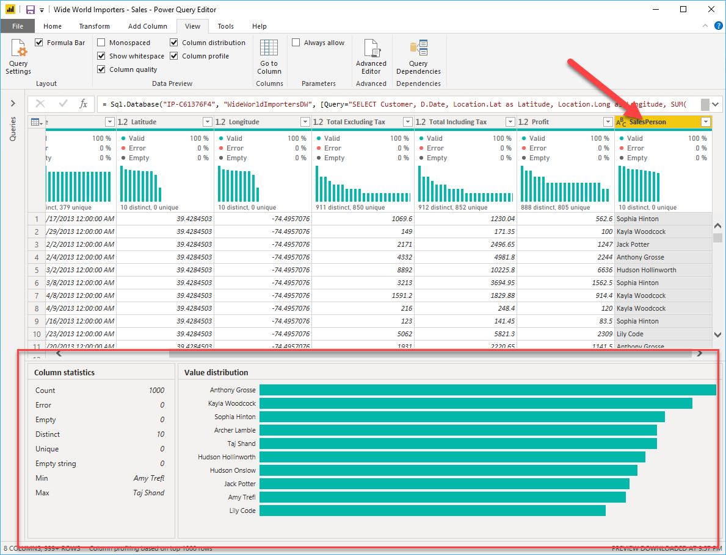
Profiling, cleaning, and transforming data
There are always few questions on Data Profiling

Slide 12
Profiling, cleaning, and transforming data
For example
You open a query in Power Query Editor. You need to identify the percentage of empty values in each column as quickly as possible.
Which Data Preview option should you select?
A. Show whitespace
B. Column profile
C. Column distribution
D. Column quality

Slide 13
Profiling, cleaning, and transforming data
For example
You have a CSV file that contains user complaints. The file contains a column named Logged. Logged contains the date and time each complaint occurred. The data in Logged is in the following format: 2018-12-31 at 08:59.
You need to be able to analyze the complaints by the logged date and use a built-in date hierarchy.
What should you do?
A. Split the Logged column by using at as the delimiter.
B. Apply a transformation to extract the last 11 characters of the Logged column and set the data type of the new column to Date.
C. Apply a transformation to extract the last 11 characters of the Logged column.
D. Apply the Parse function from the Date transformations options to the Logged column.

Slide 14
Model The Data (30-35%)
It covers
Design a data model ( Creating Relationships)
Develop a data model (Hierarchies, Cross Filter Direction and Security Filtering etc)
DAX (Measures). Usually 4-5 questions related to DAX.
Optimize model performance
So, about 15-20 questions will be from this area

Slide 15
Model The Data (30-35%)
For example
You have a data model that contains many complex DAX expressions. The expressions contain frequent references to the RELATED and RELATEDTABLE functions.
You need to recommend a solution to minimize the use of the RELATED and RELATEDTABLE functions.
What should you recommend?
A. Split the model into multiple models.
B. Hide unused columns in the model.
C. Merge tables by using Power Query.
D. Transpose the required columns.

Slide 16
Model The Data (30-35%)
For example
You have a large dataset that contains more than 1 million rows. The table has a datetime column named Date.
You need to reduce the size of the data model without losing access to any data.
What should you do?
A. Round the hour of the Date column to startOfHour.
B. Change the data type of the Date column to Text.
C. Trim the Date column.
D. Split the Date column into two columns, one that contains only the time and another that contains only the date.

Slide 17
Model The Data (30-35%)
For example
You have a Power BI report. The report contains visualizations that have interactions. You need to identify which visualizations take the longest to complete. What should you use?
A. SQL Server Profiler
B. Performance Analyzer in Power BI Desktop
C. Query Diagnostics in Power BI
D. Microsoft Edge DevTools

Slide 18
Visualize and analyze the data (25-30%)
Visualization covers
Creating Reports
Creating Dashboards
Enriching for usability (like bookmarks, custom tooltips, configuring navigation, drilldown, sync slicers etc.)
There is always 1-2 questions on designing report for people with different abilities
It will cover 15-20% of area So, about 10-15 questions will be from this area

Slide 19
Visualize and analyze the data (25-30%)
Analyzing covers
Enhancing Reports (like perform top N analysis, applying conditional formatting, quick insights
Advanced Analysis (like identity outliers, Time-series Analysis, grouping and binning etc)
It will cover 5-10% of area.
About 5-7 questions will be from this area

Slide 20
Visualize the Data (15-20%)
For example
You create a dashboard by using the Microsoft Power BI Service. The dashboard contains a card visual that shows total sales from the current year.
You grant users access to the dashboard by using the Viewer role on the workspace.
A user wants to receive daily notifications of the number shown on the card visual.
You need to automate the notifications.
What should you do?
A. Create a data alert.
B. Share the dashboard to the user.
C. Create a subscription.
D. Tag the user in a comment.

Slide 21
Visualize the Data (15-20%)
For example
Your company has training videos that are published to YouTube.
You need to surface the videos directly in a Microsoft Power BI dashboard.
Which type of tile should you add?
A. video
B. custom streaming data
C. text box
D. web content

Slide 22
Visualize the Data (15-20%)
For example
You have a Power BI dashboard that monitors the quality of manufacturing processes. The dashboard contains the following elements:
A line chart that shows the number of defective products manufactured by day.
A KPI visual that shows the current daily percentage of defective products manufactured.
You need to be notified when the daily percentage of defective products manufactured exceeds 3%. What should you create?
A. a Q&A visual
B. a subscription
C. a smart narrative visual
D. an alert

Slide 23
Visualize the Data (15-20%)
It covers
Enhancing Reports (like perform top N analysis, applying conditional formatting, quick insights
Advanced Analysis (like identity outliers, Time-series Analysis, grouping and binning etc)
So, about 5-7 questions will be from this area

Slide 24
Analyze the Data (10-15%)
For example
You need to create the On-Time Shipping report.
The report must include a visualization that shows the percentage of late orders. Which type of visualization should you create?
Scatterplot
bar chart
piechart

Slide 25
Analyze the Data (10-15%)
For example
There is a dashboard named Salary_Cost having Q&A enabled on it. When user tries to get Count of Employees, the query gets failed. On the other hand when user asks for count of Workers, the query returns expected number of results.
You need to ensure that same result is returned by both queries.Which of following actions should you perform?
Edit synonyms from Power BI Service
Edit Relationships from Power BI Desktop
Edit synonyms from Power BI Desktop
Edit tables from PowerQuery in Power BI Desktop

Slide 26
Deploy and maintain assets (20-25%)
It covers
Manage datasets (configure a dataset scheduled refresh, row level security, provide access to datasets, incremental refresh settings etc.)
workspaces (like create and configure a workspace, assign workspace roles, configure and update a workspace app, publish, import, or update assets in a workspace etc.)
So, about 10-15 questions will be from this area

Slide 27
Example: Deploy and maintain assets (20-25%)
For example
You have a Microsoft Power BI data model that contains three tables named Orders, Date, and City. There is a one-to-many relationship between Date and Orders and between City and Orders. The model contains two row-level security (RLS) roles named Role1 and Role2. Role1 contains the following filter.
City[State Province] = "Kentucky" Role2 contains the following filter.:
Date[Calendar Year] = 2020
Cond..

Slide 28
Example: Deploy and maintain assets (20-25%)
If a user is a member of both Role1 and Role2, what data will they see in a report that uses the model?
The user will see data for which the State Province value is Kentucky and the Calendar Year is 2020.
The user will see data for which the State Province value is Kentucky or the Calendar Year is 2020.
The user will see only data for which the State Province value is Kentucky.
The user will receive an error and will not be able to see the data in the report.

Slide 29
Example: Deploy and maintain assets (20-25%)
For example
You have the following three versions of an Azure SQL database:
Test
Production
Development
You have a dataset that uses the development database as a data source.
You need to configure the dataset so that you can easily change the data source between the development, test, and production database servers from powerbi.com.
Which should you do?
a. Create a JSON file that contains the database server names. Import the JSON file to the dataset.
b. Create a parameter and update the queries to use the parameter.
c. Create a query for each database server and hide the development tables.
d. Set the data source privacy level to Organizational and use the ReplaceValue Power Query M function.

Slide 30
General
There are general questions like
How you publish your report to workspace
How do you share your report

Slide 31
Example: General questions, trying to confuse
For example
You have a custom connector that returns ID, From, To, Subject, Body, and Has Attachments for every email sent during the past year. More than 10 million records are returned.
You build a report analyzing the internal networks of employees based on whom they send emails to.
You need to prevent report recipients from reading the analyzed emails. The solution must minimize the model size.
What should you do?
A. Implement row-level security (RLS) so that the report recipients can only see results based on the emails they sent.
B. Remove the Subject and Body columns during the import.
C. From Model view, set the Subject and Body columns to Hidden.

Slide 32
Thank You

